Slide 1
Assignment #10
Make characters move!
Introduction to Computers II

Slide 2
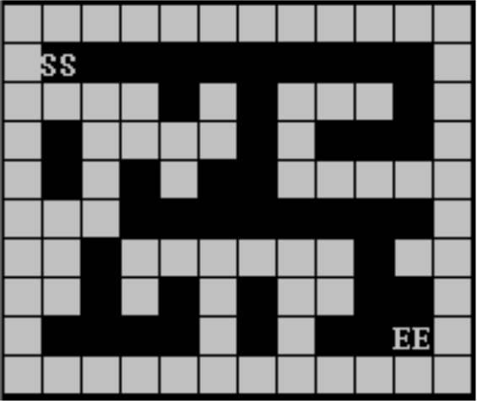
Do You Remember This?

Slide 3
Tasks
Design Field class
Trying to make a “main.cpp”
We will provide a sample interface (*.h) for you in another PPT
Sample interface of HW#9 will be provided as well

Slide 4
Field Class
Able to load several pre-defined maps and display them
Just like what we did in HW#3
Move characters by key-pressing
{W, A, S, D} or other combinations according to your own favor
Able to record and display the name and the coordinates of the map
“You are now at (104, 252) of Summoner's Rift”
Able to encounter enemies (enter to a battle)
Random encounter
By dialogue or entering specific coordinates

Slide 5
Display Map and Move Characters
Displaying maps
The space is limited
We cannot display the whole map
Only part of them are displayed!
Move characters by entering a “command”
{W, A, S, D} or ...

Slide 6
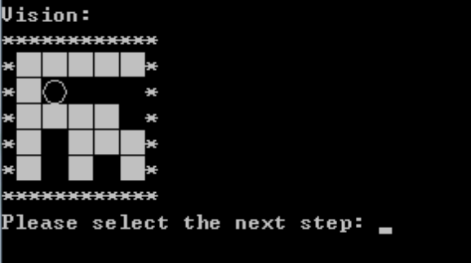
Display Map and Move Characters

Slide 7
Make a main.cpp
Till now, we have...
Players
Monsters
Battle
Field
These are basic elements of an RPG game
Please try to make a simple main.cpp (test)
Using the classes we coded so far
With simple storyline

Slide 8
Deliverables
All class headers and implementations
Players: 8 files
Monsters: 8 files
Battle: 2 files
Field: 2 files
20 files in total
submit“main.cpp” !
Please compress them into a zip archive then upload it to Moodle

